Slide 1
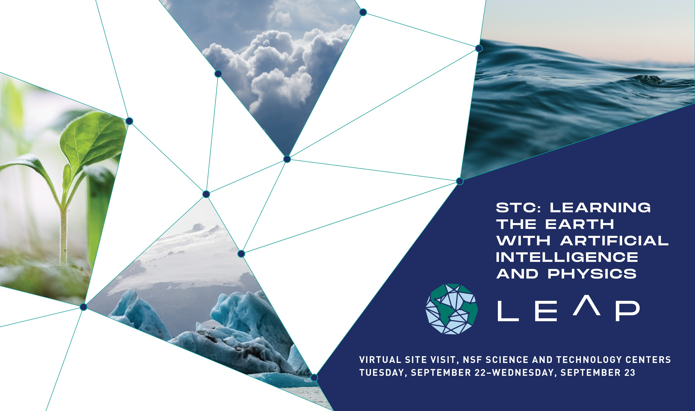

Slide 2
Response to
Overnight Questions

Slide 3
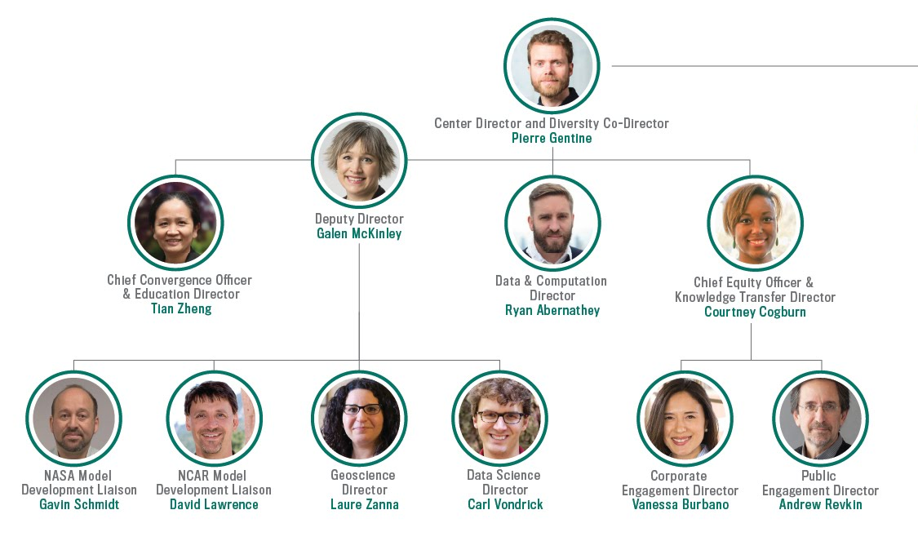
LEAP Executive Committee

Slide 4
“How would a budget reduction of 30% in each of the first two years of Center's life impact your plans? Specifically, which activities would you keep and which would you postpone/reduce?”
30% Direct Cost Budget Reduction
Year 1: Cut $1.028M
Year 2: Cut $1.035M
Operational Strategy
Delay higher-risk research
Focus on projects we know will advance to Level 3 by Year 3
Delay some broader impacts programming and staffing until full roll-out in Year 3

Slide 5
“How would a budget reduction of 30% in each of the first two years of Center's life impact your plans? Specifically, which activities would you keep and which would you postpone/reduce?”
Budget Items to Delay to Year 3 or Eliminate
Action | Line Item | Cost Savings per Year | Add Fringe?
Eliminate | Capital Equipment | $100k
Delay | Hack-a-thon | $40k
Delay | AI4Earth Summit | $30k
Delay | Journalist Workshop | $30k
Delay | “Lab-to-School” Summer Institute | $100k
Delay | 1 Knowledge Transfer Program Manager | $77k | Yes

Slide 6
“How would a budget reduction of 30% in each of the first two years of Center's life impact your plans? Specifically, which activities would you keep and which would you postpone/reduce?”
Budget Items to Reduce in Year 1 and 2
Action | Line Item | Cost Savings per Year | Add Fringe?
Reduce | DEI Consultant | $50k | Yes
Reduce | 3 fewer Fellows - Stipend | $125k | Yes
Reduce | 3 fewer Fellows - Tuition | $76k
Reduce | 2 fewer Postdocs | $120k | Yes
Reduce | 1 fewer Bridge Postbac | $46k | Yes
Reduce | 1 fewer Cloud Engineer | $100k | Yes
Reduce | Trainee NCAR Rotations | $25k
Reduce | Publication Costs | $40k

Slide 7
“How would a budget reduction of 30% in each of the first two years of Center's life impact your plans? Specifically, which activities would you keep and which would you postpone/reduce?”
Revised percentages reflect ramp-up priorities
LEAP Initiative | Proposed Percentage | Revised Percentage | Difference
Research | 51% | 60% | +9%
Education | 19% | 14% | -5%
Broadening Participation | 9% | 8% | -1%
Knowledge Transfer | 10% | 9% | -1%
Management & Operations | 11% | 9% | -2%

Slide 8
“How many committees will each member of the LEAP executive committee be on? This would be easiest viewed as a matrix of people in the rows and meetings / committees / working groups in the columns.”
Monthly Meetings for LEAP Executive Committee
LEAP Executive Team | Number of Committees | Executive Committee | Convergence Subcommittee | Knowledge Transfer Subcommittee | Research Working Groups | Executive Coaching | Dean’s Mentorship
Gentine | 5
McKinley | 4
Abernathey | 3
Burbano | 3
Cogburn | 3
Lawrence | 3
Revkin | 2
Schmidt | 2
Vondrick | 3
Zanna | 3
Zheng | 3

Slide 9
“How many committees will each member of the LEAP executive committee be on?”
Additional Executive Committee Commitments, Year 1 + 2
Everyone: LEAP Management Institute
  1.5 hours per month
  Year 1
Lead PI Gentine: Provost Leadership Fellows
  2 hours per month
  Years 1 + 2

Slide 10
“How many committees will each member of the LEAP executive committee be on?”
Annual Commitments: All Executive Committee
March: Director’s Council (4 hours)
May: External Advisory Board (1 day)
August: Annual Meeting (3 day)
Annual Commitments: Individual Members
January: Funding Review Panel (1 Convergence Subcommittee member, rotating)
March + November: Corporate Working Group (Burbano)
August: Set research working groups (Zanna + Vondrick)

Slide 11
“For each of the 5 members of the leadership team, what do you see over the next 5 years will be the fraction of your effort devoted to LEAP-related research, LEAP-related administration, and teaching?”
Important Step #1: Increase Abernathey, Cogburn + Zheng effort to 1.5 months
Leadership | Proposed Effort | Revised Effort | Research | Administration | Teaching *
Gentine | 3 |  | 1 | 2 | Institutional
McKinley | 2 |  | 1 | 1 | Institutional
Abernathey | 1 | 1.5 | 1 | 0.5 | Institutional
Cogburn | 1 | 1.5 | 0.5 | 1
Zheng | 1 | 1.5 | 0.75 | 0.75 | Institutional
* All LEAP-related teaching covered by 9-month salary as teaching faculty.
New courses are aligned with existing departmental needs.
NSF funds do not support LEAP teaching.

Slide 12
“Your proposal was written about 8 months ago. Since then we have all experienced changes in our everyday life as well as changes in how science and education are conducted. If you were to write this proposal now, briefly describe what would you change?”
A new realization of our capability to work with anyone anywhere in the world. Mechanisms to enhance research, education, DEI and knowledge transfer that could be enhanced are:
  Educational courses offered across the partner universities
  Links to HBCU institutions
  Connections to affected companies and countries around the world
If we were to write this proposal now, we would increase investment in hardware and software to improve the experience of remote meeting and teaching.
  More sophisticated equipment in LEAP HQ conference room and partner institutions
  More training in “virtual teaming”
  Broader partnership formation across geographies
  A shift in the storyteller in residence and journalism fellowships to an “online first” relationship
Notes:
More integration of the new online Climate Resilience Project at the Earth Institute (http://j.mp/resiliencemedia) - a series of seminars already engaging hundreds of journalists around ways to incorporate resilience concepts into their reporting.
A shift in the storyteller in residence and journalism fellowships to an “online first” relationship - with the online focus greatly increasing the capacity to connect with journalists and creative communicators in widely distributed communities of color and in highly vulnerable regions around the world (like an active disaster-risk reduction whatsapp community in Africa).

Slide 13
“Your proposal was written about 8 months ago. Since then we have all experienced changes in our everyday life as well as changes in how science and education are conducted. If you were to write this proposal now, briefly describe what would you change?”
The other major shift in 2020 has been a heightened awareness of systemic racism. It has spurred increased attention and investment to address this issue at Columbia and our partner universities that LEAP can now leverage to support its DEI strategies.
If we were to write this proposal now, we would highlight a variety of activities that are synergistic with LEAP’s work. For example, just at Columbia:
Cogburn is leading a new Deans’ Council institute focused on anti-racism created by the Provost;
Bell, Kingslake and McKinley are members of a new DEI taskforce at Lamont Doherty Earth Observatory instigated by Senior Personnel and LDEO Interim Director Raymo; and
McKinley chairs the diversity committee for Earth and Environmental Sciences, and in this capacity has joined a new “super-group” of the chairs of diversity committees of the science departments within Columbia Arts & Sciences. Several of the departmental committees have just been formed.

Slide 14
“There is already strong collaboration between geoscientists and AI (e.g. at NOAA), how does the creation of a LEAP STC lead to synergies that aren't going to occur on their own as science and data science naturally converge?”
AI strategies at organizations like NOAA and NASA emphasize the importance of AI research but don’t provide the focused structure needed to fully integrate ML and Climate research via the creation of a new discipline. For this, an STC is needed.
LEAP will accelerate + coordinate convergence between data science + climate science, with sustained effort over 5 - 10 years
Synergistic approach will drive advances in both data science + climate science

Slide 15
“There is already strong collaboration between geoscientists and AI (e.g. at NOAA), how does the creation of a LEAP STC lead to synergies that aren't going to occur on their own as science and data science naturally converge?”
More reliable decadal-century timescale projections are only possible through Center coordination
  New ML physics-guided algorithms
  Improvement of Earth System models with uncertainty representation + reduction of structural model errors
    Advance beyond prior efforts aimed at reducing initial condition uncertainty for weather forecasts or improving speed of parameterizations through emulation.
Education of climate data scientists to become the next generation of ESM development + analysis leaders

Slide 16
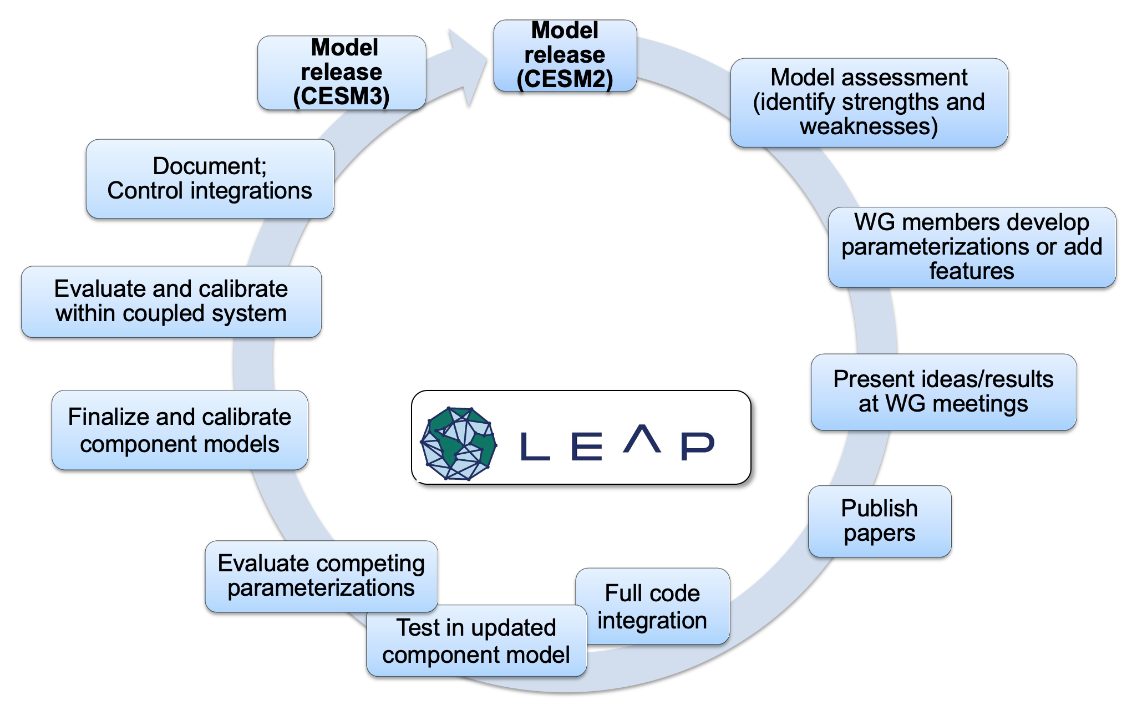


“There is already strong collaboration between geoscientists and AI (e.g. at NOAA), how does the creation of a LEAP STC lead to synergies that aren't going to occur on their own as science and data science naturally converge?”
Based on prior experience with conventional parameterizations, implementation of ML-based parameterizations into ESMs will encounter unforeseen challenges.
Again, the sustained effort afforded by an STC will provide platform to achieve success with full circuit of model development.

Slide 17
“The presentation showed how the current understanding of physics can supplement ML to develop better models. But how can the results from these physics-informed models advance our understanding of the underlying physics?”
Center Culture:
Climate science PIs (e.g. Gentine, Zanna, McKinley, Abernathey, etc.) are fundamentally motivated by a desire for better physical understanding, with data science and machine learning as a way to break long-standing deadlocks.
Cultivating investigation of physics <-> machine learning through 2-way feedback, including:
  Research led by co-directors in geoscience + data science
  Education with new curriculum
  Senior personnel team including climate scientists + data scientists supervising graduate students + postdocs
  Convergence luncheons

Slide 18
“The presentation showed how the current understanding of physics can supplement ML to develop better models. But how can the results from these physics-informed models advance our understanding of the underlying physics?”
Overall Research Strategy: bi-directional transfer between the fields, forging opportunities for scientific discovery
Using domain knowledge to ask questions from the data: identify cause and effect with causal inference (e.g., recent paper on Lorentz’s model causal relationship)
Using data to discover gaps in our knowledge:
- > data science will become an indispensable tool for scientific discovery on the Earth climate.

Slide 19
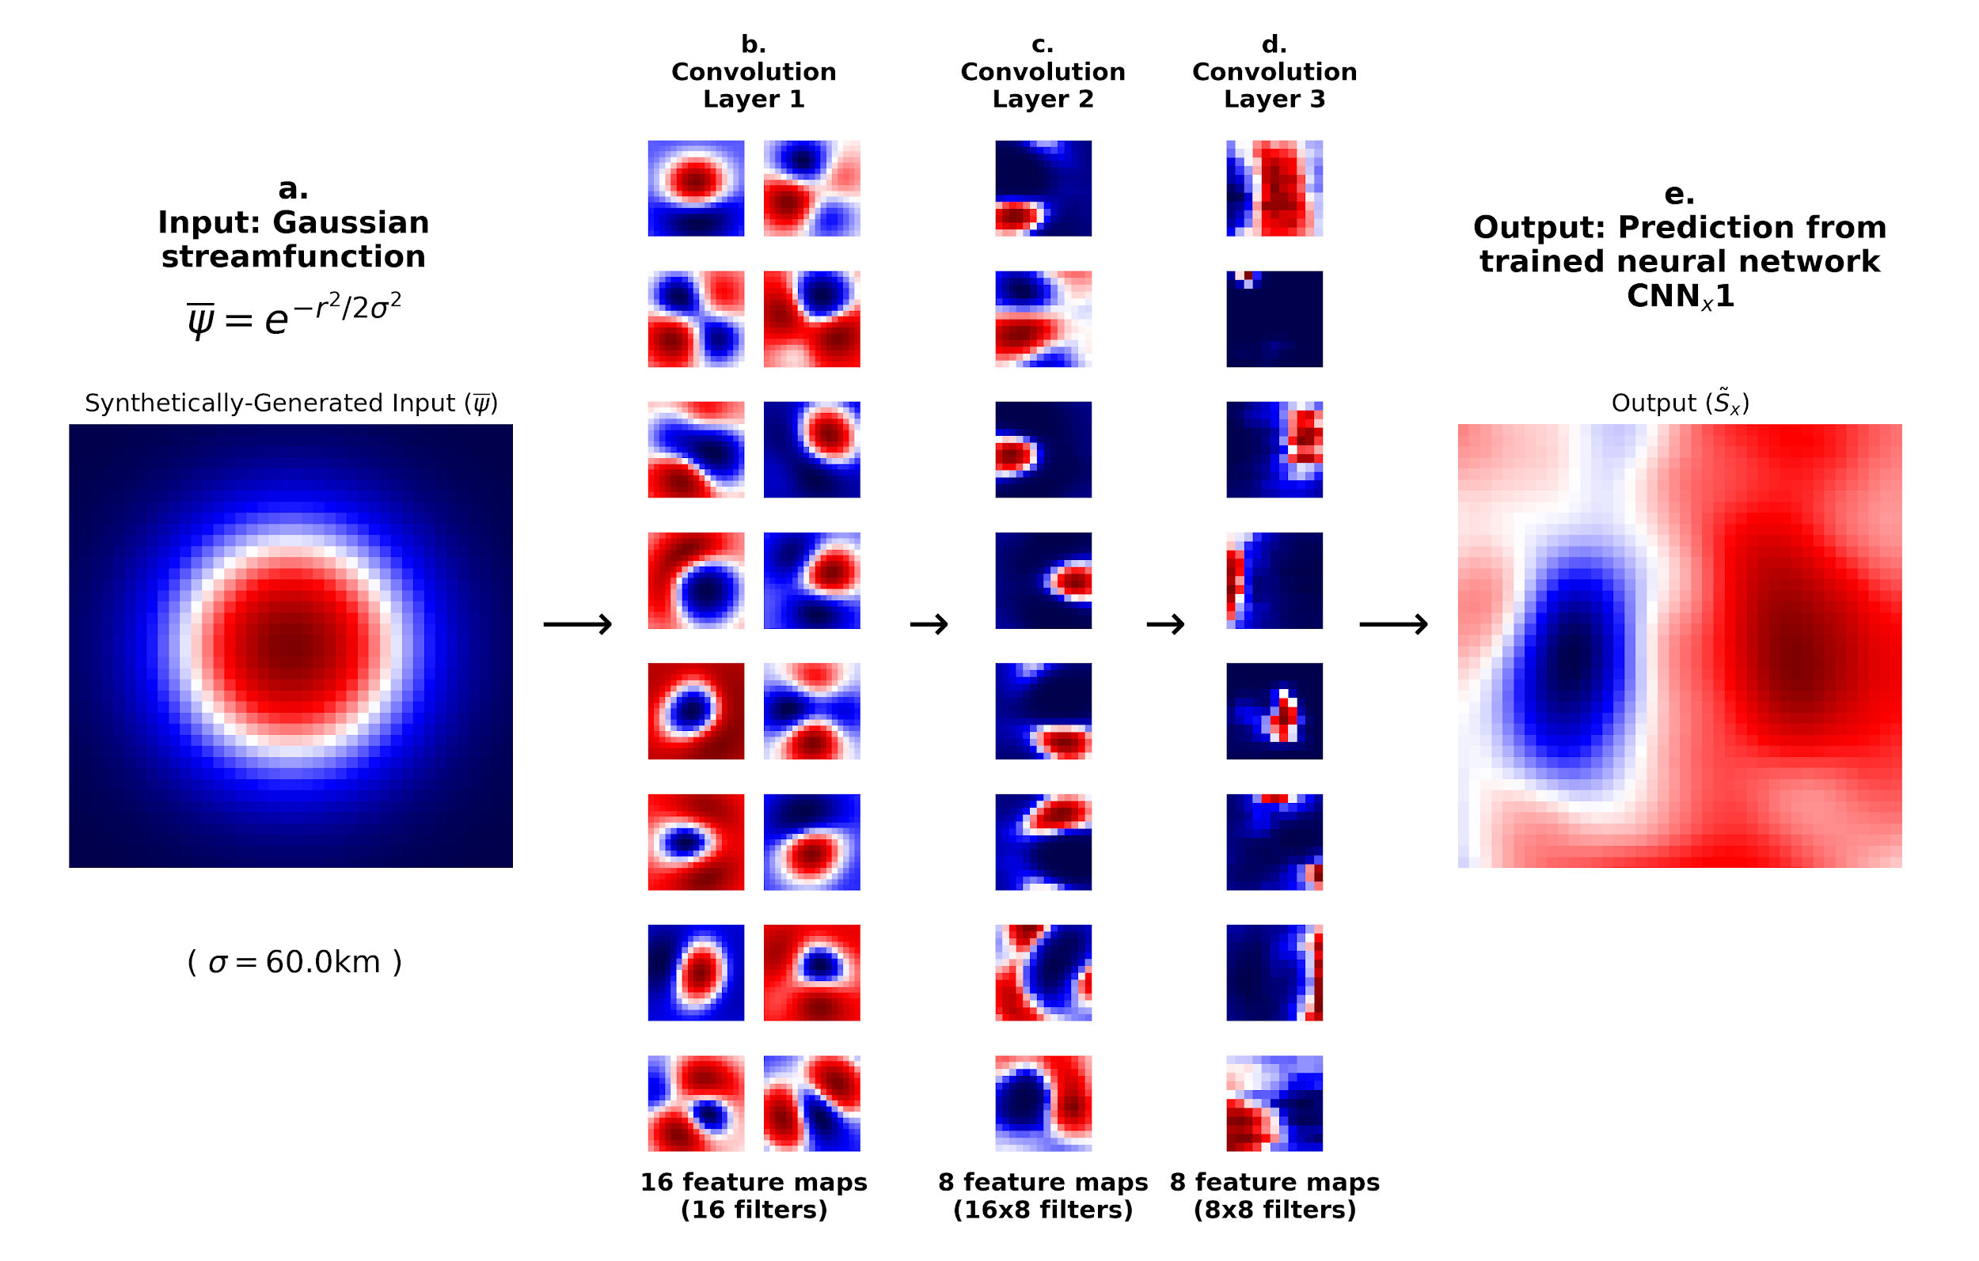
“The presentation showed how the current understanding of physics can supplement ML to develop better models. But how can the results from these physics-informed models advance our understanding of the underlying physics?”
Proof-of-Concept Examples
Ocean turbulence (Zanna) + atmospheric convection & turbulence (Gentine + Pritchard) in which we interrogated the deep learning & equation discovery.

Slide 20
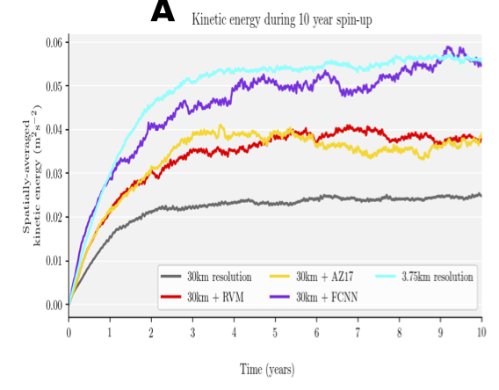
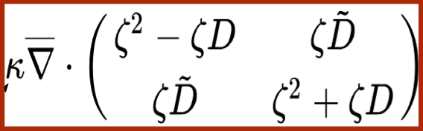
“The presentation showed how the current understanding of physics can supplement ML to develop better models. But how can the results from these physics-informed models advance our understanding of the underlying physics?”
Proof-of-Concept Examples
Ocean turbulence (Zanna) + atmospheric convection & turbulence (Gentine + Pritchard) in which we interrogated the deep learning & equation discovery.

Slide 21
“How will LEAP ensure that it advances the state-of-the-art in data science and machine-learning, not just in climate science, and ensure that the data science community is made aware of these advancements?”
Climate science problems are drivers of mathematical & computational innovation
Center structure requires integration + co-development
LEAP data scientists are well-equipped to disseminate findings
Notes:
This relates to the social media and public engagement strategies as well. Along with CONVERGENCE (focusing in) there will be outward-spilling engagement across issue silos.

Slide 22
“How will LEAP ensure that it advances the state-of-the-art in data science and machine-learning, not just in climate science, and ensure that the data science community is made aware of these advancements?”
LEAP requires advances in ML fundamentals. Four areas represent frontiers for ML state-of-the-art:
  Physical Constraints
  Extrapolation
  Generalization
  Interpretability
Doctoral students + postdocs in data science + ML must innovate in order to publish
Convergence strategies will leverage these research + training needs to ensure that we contribute to ML state-of-the-art

Slide 23
LEAP investigators are well equipped to disseminate research findings in data science
Dissemination in ML Journals + Conferences (NeurIPS, ICML, ICLR, Nature Machine Intelligence)
  We know how to publish here!
Publishing in diverse venues enables knowledge transfer to other machine learning domains
LEAP’s team organizes conferences and teaches courses in ML, data science, statistics
Notes:
Avenues for dissemination
ML Journals
ML Conferences
We already have a track record of taking ML advances motivated by climate science and publishing them in a more general context

Slide 24
“How would you improve discoverability of assets located in LEAPangeo to support FAIR principles? How would this support both the unique search perspectives of climate scientists and data-scientists?”
Three Pangeo asset types must be FAIR
LEAPangeo assets = {data, code, models}
Enabling all participants, partners + the broader community to discover + use these assets is key to both the intellectual merit + broader impacts
FAIR principles, as implemented in best practices/ standards from bodies like EarthCube/ ESIP/ OGC, will be applied to all assets

Slide 25
“How would you improve discoverability of assets located in LEAPangeo to support FAIR principles? How would this support both the unique search perspectives of climate scientists and data-scientists?”
Findable | LEAPangeo data cataloged using Spatiotemporal Asset Catalog standard (STAC).
Accessible | LEAP will share datasets in cloud object storage. ARCO data formats (e.g., Zarr), enable quick looks at the data + metadata, and facilitate massive-scale distributed processing.
Interoperable | All formats used in LEAPangeo will use openly licensed specifications (e.g. NetCDF, Zarr, STAC), which have implementations in many different scientific programming languages (e.g. Python, Julia, R).
Reusable | Datasets published in LEAPangeo will adopt Creative Commons licenses.

Slide 26
“How would you improve discoverability of assets located in LEAPangeo to support FAIR principles? How would this support both the unique search perspectives of climate scientists and data-scientists?”
Findable | LEAP will use GitHub as primary code collaboration platform, with advanced features for code search + is well indexed by major search engines. LEAP will automate GitHub + Zenodo linkage to generate Zenodo archives (with DOI) for all code releases. LEAP’s website will provide a browseable + searchable front-end for discovering all these code assets.
Accessible | GitHub + Zenodo will provide full accessibility. LEAP will strive to publish Binders for all code releases.
Interoperable | LEAP code releases will strive to use only open-source dependencies. Environment specifications, required by binder, will be published with code, further enhancing interoperability by enabling re-creation of the environment in which the code was run.
Reusable | All Pangeo code releases will employ OSI-approved open-source licenses, facilitating reuse in other research projects or commercial applications.

Slide 27
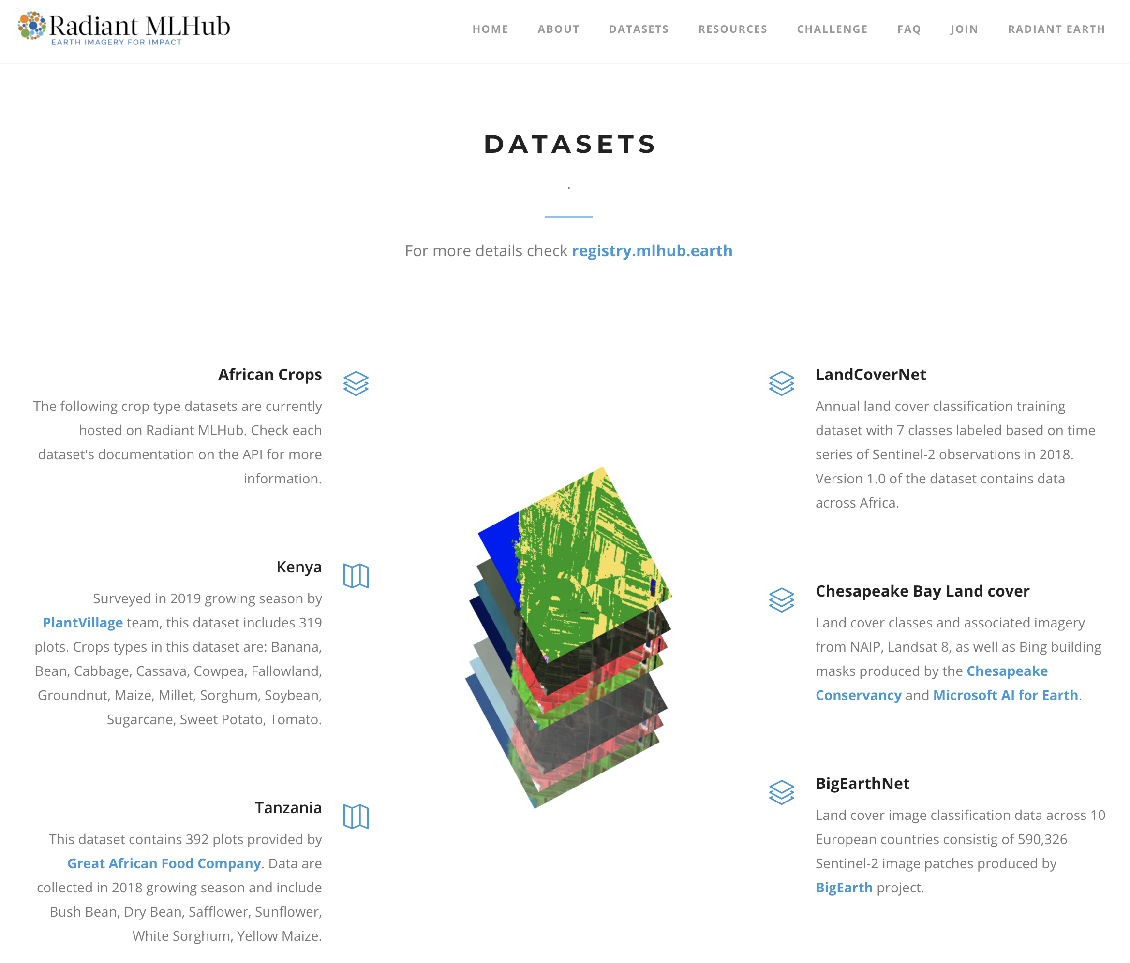
“How would you improve discoverability of assets located in LEAPangeo to support FAIR principles? How would this support both the unique search perspectives of climate scientists and data-scientists?”
FAIR standards for sharing trained ML models are not yet established.
LEAP will participate in + contribute to the development of such standards
In the meantime, we have some great examples to be inspired by:
  Radiant Earth ML Hub
  Openml.org
  ONYX

Slide 28
“How would you improve discoverability of assets located in LEAPangeo to support FAIR principles? How would this support both the unique search perspectives of climate scientists and data-scientists?”
Data science challenges will help new audiences discover climate science challenges
LEAP will contribute datasets + leaderboards to ML challenges on platforms like Kaggle + at conferences
This will be a great way to engage ML researchers in climate modeling
LEAPangeo’s convergence between Climate Science + ML will enable us to create great challenge problems

Slide 29
“How, concretely, will LEAP serve as an exemplar for other subject domains to be able to emulate? How will those other interested groups be facilitated in creating their version of LEAP through processes LEAP pioneered?”
Broadly disseminate best practices of LEAP’s processes via publication, presentations, public communications + social media.
Make all products from our processes open-source, facilitating adoption by other interested groups.
Open events to interested groups, who can attend as participants and/ or observers.
Extend invitation to attend our annual meeting to interested mid-career scientists from other subject domains who aspire to create their version of LEAP.

Slide 30
“How could the partnership program be expanded to incorporate organizations' interest in LEAP outputs (some industry have strong interests in the data climate outputs, but there are other intermediate outputs/assets that companies could be interested in) beyond just climate-specific datasets and simulation results?”
LEAP holds potential to provide value to private sector in additional knowledge domains beyond climate science:
  Algorithms + physics-guided AI are general technology with many applications
  DEI learnings are potentially relevant for companies looking to embed DEI in their organizations
Corporate engagement bi-directional feedback loops will be used to gather information on what is specifically valuable

Slide 31
“How could the partnership program be expanded to incorporate organizations' interest in LEAP outputs (some industry have strong interests in the data climate outputs, but there are other intermediate outputs/assets that companies could be interested in) beyond just climate-specific datasets and simulation results?”
Under Current Scope
All the LEAP outputs - data, models, and code - will be open source and made publicly accessible on the LEAPangeo platform
Potential Expansions to Scope Could Consider:
  “Climate Information Portal” reconceptualized as “LEAP Information Portal”
    LEAP could aggregate, distill + disseminate for a corporate audience physics-guided-AI-related knowledge outputs, including white papers on the technology + best practices learned from implementing the technology.
    LEAP could aggregate, distill + disseminate practitioner-oriented DEI learnings
  Addition of a corporate partner to represent interest in physics-guided-AI-related outputs from LEAP.
  Alternatively: Engage Waymo (owned by parent company of current partner, Google)

Slide 32
What does high-level success look like 3-years in from the perspective of each of the five leadership areas?

Slide 33
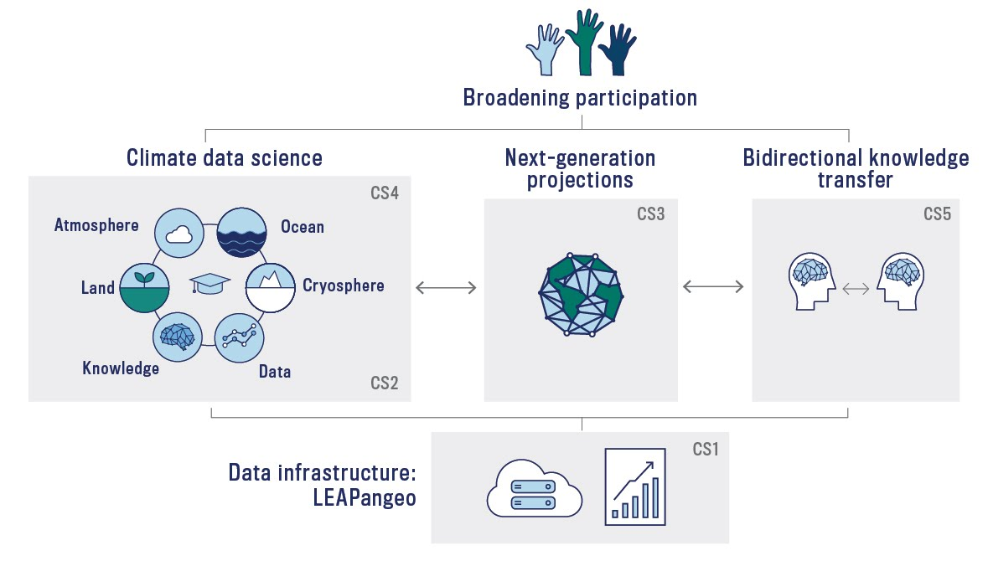
Five Convergence Strategies (CS)
Drive LEAP’s Vision
CS4: Equitably + inclusively train climate data scientists
CS2: Create next-generation algorithms
CS5: Establish bidirectional knowledge transfer
CS3: Develop
next-generation CESM
CS1: Revolutionize geoscience data infrastructure

Slide 34
CS1: Revolutionize Climate Data Infrastructure
Challenge: Massive + heterogeneous datasets
Solution: LEAPangeo: open-cloud computing platform
3-Year Successes
Majority of research computing by LEAP participants occurs within the platform
Active dialogue between LEAP scientists + software developers.
Significant data usage by partner institutions and the broader community.
Notes:
High volume of activity by LEAP participants within the platform. All major research activity should be taking place within LEAPangeo, not because participants are “forced” to, but because they are genuinely more productive and collaborative this way. Conversely, failure would mean participants fall back to their own private workflows and analysis environments.
Active dialog between LEAP scientists and software developers. The Agile development methodology we intend to use means that LEAPangeo will never be “finished.” Rather, the platform should continuously evolve in response to user needs. Users should be engaged in reporting bugs and suggesting features, and developers should be responding quickly to such feedback.
Significant data usage by partner institutions and the broader community. A major thrust of our knowledge transfer strategy is to expose climate data to the world in a useful format using cloud computing and the LEAPangeo platform. By year 3, partner institutions and other non-partner institutions in the broader community should be actively “consuming” LEAPangeo data and using it for diverse purposes, including research and education.

Slide 35
CS2: Create Next-Generation Algorithms
Challenge: ML algorithms need to respect physics, better extrapolate + be interpretable
Solution: Include physical + causal knowledge to robustly extrapolate + understand
3-Year Successes
Several hard constraints (mass and energy) built into deep learning algorithms will have been developed.
Embedding causal inference into ML to improve generalization (e.g. unseen climates).
Understanding of 2-3 processes using equation discovery (e.g., ocean and atmospheric turbulence).
Notes:
Several implementations of hard constraints and physical invariance built into deep learning algorithms will have been developed. By year 3, we will specifically target conservations of energy and mass which are critical for climate change simulations. These algorithms will be usable across Earth components (land, atmosphere, ocean, cryosphere) but we hope that they could also be used in other disciplines (which are at the intersection between physics and data rich environments e.g. mechanical engineering). Two to three papers will have been published in either conferences or journals. Codes will be shared on GitHub and their adoption will be used as an assessment metric too.
Embedding causal inference into ML to improve generalization (e.g. unseen climates). Algorithms will have been developed that can include causal inference into ML to reduce spurious correlations and consequent instabilities in the models. An example of such an issue was highlighted by Brenowitz et al. 2020: spurious correlations between the stratosphere and the lower part of the atmosphere (boundary layer) were present when using a deep neural network to replicate moist convection in the atmosphere. These spurious correlations led to instability of the deep neural network model when implemented as a parameterization of convection in a coarse-resolution model. At least two papers will have been published, one showcasing the methodology and the other one demonstrating the application to one of LEAP’s subcomponents (e.g. moist convection in the atmosphere). Codes will be shared on GitHub and used as an assessment metric too.
Understanding of processes using equation discovery. By year 3, we will have discovered new understanding of two or three processes (either physical or biogeochemical) proving interpretable explanations, including via distilled equations. Specifically we hope to understand processes such as atmospheric convection or photosynthesis, in addition to refining ocean turbulence work pioneered by Zanna (Zanna and Bolton 2020) to more dynamical regimes and climate conditions. We expect to publish two manuscripts on this strategy.

Slide 36
CS3: Develop Next-Generation CESM
Challenge: Create high-reliability climate projections
Solution: Harness new ML + data to transform the open NSF-funded Community Earth System Model (CESM)
3-Year Successes
Corrections of several model structural errors using ML - implementing 3-5 ML-based parameterizations into CESM subcomponent (convection, ocean turbulence, warm clouds microphysics).
Metrics:
  Use existing metrics to evaluate ML performance
  Advance several metrics based on new (2-3) data products with uncertainty quantifications
Systematically tune parameters based on existing metrics using Bayesian parameter inversion + emulators of model subcomponents.
Notes:
Corrections of model structural errors using ML: One of the important goals of LEAP is to reduce model parameterization structural errors (incorrect representation of the physics or biology leading to large biases). In three years we will have defined success if LEAP can implement several (3-5) ML-based parameterizations into CESM component models (atmosphere, land, ocean, land ice). Potential candidate parameterizations which are already at or close to the Level 2 stage (ready for implementation into component models), but need to be tested further, e.g., for numerical stability, impact on other coupled processes, and suitability in different climate regimes (e.g., warm/cold) would be (1) atmospheric convection (Gentine et al. 2018), (2) ocean turbulence and eddies (Bolton and Zanna, 2019), (3) warm cloud bin microphysics (Gettelman et al., 2020), and (4) physics-guided ML for streamflow (Yang et al., 2019).
Metrics and data products: In years 1-3 LEAP scientists will utilize existing metrics packages to more comprehensively evaluate new ML-based parameterizations. This exercise will have two benefits. (1) It will provide a more comprehensive assessment of impact of new ML-based parameterizations on component model performance. (2) It will reveal limitations of existing metrics packages (for example, for the most part existing packages do not assess the ability of a model to replicate statistics of higher order moments, like extremes). In parallel, we will have developed new data “products” with clear uncertainty quantification that will be used to refine model metrics performance. In particular, we want to go beyond typical mean square errors at the global for the global evaluation of models. Instead, the uncertainty quantification in space and time of various products (e.g. pCO2 Gloege and McKinley 2020 or photosynthesis and evapotranspiration Alemohammad et al. 2017) will be used to refine standard metrics and attribute varying weights (spatially) depending on the uncertainty quantification - regions with high uncertainty will be given a lower weight during the model metric evaluation. We expect to have developed several global products (2-3) with quantified uncertainties and developed 2 metrics using those products.
Parameter estimation: For the parameter estimation, by year 3, we will have expanded on the work of Elsaesser and Dagon for systematic tuning of parameters based on existing metrics (e.g. ILAMB for Land) using a Bayesian parameter inversion and emulators of the model subcomponents (land, atmosphere, ocean, cryosphere). This relates to an earlier point of the reviewers that this component of LEAP has parallels with data assimilation in numerical weather prediction for parameter estimation (data assimilation can also be used for parameter estimation in addition to state estimate). This will be achieved with first dimensional reduction so we can achieve Bayesian parameter estimation and limit the dimensionality of the problem following on recent work from the group (Dagon et al., 2019; Elsaesser et al., 2020). Here, we will use an emulator of the CESM subcomponents to more easily compute the “adjoint”/sensitivity of the outputs and metrics’ response to model parameters instead of the very computationally expensive model itself. This work will leverage recent NCAR’s efforts in large parameter perturbation ensembles for parameter tuning. We expect that this strategy will have been deployed across CESM subcomponents by the end of year 3.

Slide 37
CS4: Equitably + Inclusively Train
Climate Data Scientists
Challenge: Distinct fields + vocabularies limit collaborations + progress
Solution: Forge the new climate data science discipline via convergence between education + research
3-Year Successes
Four existing courses, one project-based (Climate prediction challenges), two convergence seminars
  supported by six Design Studio Interns
  One Certification Program with virtual options enabled
  > 60 students participate in LEAP curriculum
Research Experiences for >70 participants across 5 different programs
Participation of > 30 students from underrepresented populations across LEAP’s education programs
Participation of > 20 faculty members in LEAP’s education programs (curriculum, “train the trainer”, mentorship)
Notes:
Fully developed curriculum that attract strong student interest, quantified as:
Four existing courses updated with LEAP-research integrated modules, case-studies and projects, with virtual options, supported by LEAP’s Design Studio, facilitated by the LEAPangeo platform.
One new project-based course (Climate prediction challenges).
Two new convergence seminars driven by active LEAP research.
Six Design Studio interns over three years for designing and supporting research-education integration.
20 students (with > 30% from either data science or climate science) each year participating in LEAP’s certification programs.
At least two students from each LEAP university partner participate in LEAP’s certification programs.
Research Experience Programs with robust participation, quantified as:
Six doctoral dissertations will be in the advanced stages of development (completed qualifying exams, published at least one manuscript or contributed significantly to code development).
> 20 applicants each year have participated in the summer Research Internship program.
12 summer interns (three cohorts of four) will have produced publishable (in journals or conferences) high-quality research results, leveraging the LEAPangeo platform, and with >30% of them choosing to further their studies or careers at the interface between climate and data science (climate data science) or to use their newly acquired technical skills to find a position in private or public sectors (e.g., government, startups, reinsurance companies, weather and risk companies).
> 10 high school students each year have participated in LEAP’s offering in the Science Honor Program.
~ 10 public school sustainability coordinators (NYC K-12 science teachers) have participated in LEAP’s “Lab to School” program. >30% of them will be willing to adopt their developed teaching units informed by LEAP’s research in their classroom.
Broadened Participation from students from underrepresented populations will have been increased towards a trajectory to be on par with US population within 5-10 years
Three LEAP summer visitations to NCAR with SOARS Integration.
Engage > 15 of returning SOARS protégés in LEAP’s summer workshop over three years at NCAR.
> 2 SOARS protégés mentored by LEAP researchers over three years.
> 2 returning SOARS protégé participates in LEAP summer research internship program over three years.
Three Bridge-to-PhD scholars will have been supported by LEAP and will have settled PhD positions after their Bridge (typically lasts two years) with an acceptance rate above standard > 66%.
Up to 15 (three cohorts of five) students though the National Society of Black Engineers participating in LEAP certificate courses.
Broader faculty interest: we will have witnessed strong interest from Faculty and Trainees in LEAP’s education programs
> 10 faculty members participate in LEAP curriculum.
> 20 faculty members participate in LEAP “train the trainer” workshops
> 20 faculty members actively mentor research trainees through LEAP fellowships, postdocs and summer internships.

Slide 38
CS5: Establish Bidirectional Knowledge Transfer
Challenge: Better climate modeling will not increase climate adaption alone
Solution: Bidirectional communication across academia, modeling centers + diverse stakeholders
  Advance climate modeling utility, reach + relevance
DEI 3-Year Successes
Strategy + recruitment recommendations disseminated via:
  3 annual reports
  2 major academic publication (e.g. Science, Harvard Business Review, Harvard Data Science Review)
  Presentation or workshop on DEI at two major STEM conferences (e.g. NeurIPS, Joint Statistical Meetings, Academic Data Science Alliance, American Geological Union)
Two community based climate organizations (e.g. NYC Office of the Mayor, Trust for Governors Island) will be trained, provided user-interface feedback and will be utilizing LEAPangeo
Notes:
DEI and Broadening Participation:
DEI strategy overview, empirically grounded recommendations regarding recruitment and STEM DEI strategies will have been disseminated in the form of 3 annual reports, two major academic publications (e.g. Science and Harvard Business Review, Harvard Data Science Review) and presentation or workshop at a two major STEM conferences (e.g. NeurIPS, Joint Statistical Meetings, Academic Data Science Alliance, American Geophysical Union)
The Inclusive Science Module based on formal annual assessments of the LEAP DEI strategy will be made publicly available online and promoted as part of other dissemination activities (e.g. publication, conferences, workshops)
We will have co-hosted the first of two AI4EARTH conferences with Microsoft with over 300 attendees (this may expand if virtual) including broad participation from our educational program participants.
Two community based public organizations (e.g. NYC Office of the Mayor, Trust for Governors Island) will be trained, will provide user feedback, and will be utilizing LEAPangeo data and computing to support their distinct missions.

Slide 39
CS5: Establish Bidirectional Knowledge Transfer
Challenge: Better climate modeling will not increase climate adaption alone
Solution: Bidirectional communication across academia, modeling centers + diverse stakeholders
  Advance climate modeling utility, reach + relevance
Corporate Engagement 3-Year Successes
1,000+ corporations sent annual corporate engagement survey requesting information on what is useful to them + to disseminate information about the knowledge outputs currently available from LEAP
From those Feedback gathered from 100+ corporations on data and informational needs/ preferences (annual surveys, feedback from website, partner organization engagement)
Active use of the LEAP portal by 30+ corporations/ entrepreneurs/ organizations
Notes:
Corporate Engagement
1,000+ corporations sent annual corporate engagement survey to ask for information on what is useful to them and to disseminate information about the knowledge outputs currently available from LEAP
Feedback gathered from 100+ corporations regarding data and informational needs/preferences (via annual surveys, feedback from website portal, in addition to partner organization engagement)
Active use of the LEAP portal by 30+ corporations/ entrepreneurs/ organizations

Slide 40
CS5: Establish Bidirectional Knowledge Transfer
Challenge: Better climate modeling will not increase climate adaption alone
Solution: Bidirectional communication across academia, media, modeling centers + diverse stakeholders
  Advance climate modeling utility, reach + relevance
Public Engagement 3-Year Successes
Active web-based interface engaging news media + civil society organizations to tap LEAP output and expertise
    At least a dozen references to LEAP in maps, reports, news stories + web features
LEAP has a place in discourse around high-level climate adaptation + resilience goals (through our work with UCCRN and involving organizations like the Global Center on Adaptation)
Host a virtual conference featuring the insights and output of LEAP Storytellers in Residence, Journalism Fellows and Translate-a-thon participants.
Notes:
Public and Media Engagement
Building on our early co-production work with Climate Central, Earth Journalism Network and other partners, by year 3 LEAP will have an active interface (web-based) through which news media (and civil society organizations) trying to identify and cut exposure and vulnerability to climate-related hazards are actively drawing on LEAP’s emerging 10-40-year climate projections. We anticipate at least a dozen references in year 3, with LEAP output referenced in maps, reports, news stories and web features pursuing climate resilience and adaptation capacity.
By year 3 we will host an online conference (with at least 1,000 “attending” - in line with Sustain What segments which are getting several thousands viewers per episode) targeting climate-focused media, students and community organizations and featuring the insights and output on climate-data science of at least 20 LEAP Storytellers in Residence, Journalism Fellows and Translate-a-thon participants from years 1 and 2.
Through sustained outreach to, and engagement with, data-focused environmental journalists, at least one major news feature story or series (e.g. Science Magazine, NYT) on LEAP’s climate-data science innovations will provide a compelling overview of the project’s genesis and impacts.
A video series will be posted showing the genesis and learnings of LEAP, built around highlights from LEAP-focused Earth Institute webcasts and the various LEAP events.

Slide 41
If You Need to Contact Us
Lead PI: pg2328@columbia.edu
All Presenters: leap@columbia.edu
Columbia Engineering Dean Mary Boyce: mb3814@columbia.edu
Admin Support: mb3952@columbia.edu
THANK YOU!!

Slide 42
“How would a budget reduction of 30% in each of the first two years of Center's life impact your plans? Specifically, which activities would you keep and which would you postpone/reduce?”
Remove
Capital equipment ($100k, off-set by Google + Microsoft)
Hack-a-thon ($30k)
3 Fellows/ grad students
  Stipend: $125k + fringe
  Tuition: $76k
2 postdocs ($120k + fringe)
1 cloud engineer ($100k + fringe)
Knowledge Transfer program manager ($77k + fringe)
Reduce
Student + postdoc NCAR rotations: travel + lodging ($25k)
Publication costs ($40k)

